Slide 1
The data sea
Social Entrepreneurship and Sustainability In B2B
Date:- 16/05/2022

Slide 2
Why?
Why did you decide to solve this Problem statement?
As a team, we felt like a metaverse is new to the world, NFT, web0. Artist people are interested in the same thing. So you are imagining something that could be Unfold the walls of your home, and you can own the non-fungible tokens you have in exchange for money that you are indestructible but add value to your money.
In society we just need to let people know about it in INDIA and yes, artworks are also for gifting purposes or for their use, love for works of art. art.
So you are imagining something that could be

Slide 3
User Segment & Pain Points
Which user /advertiser segment would be early adopter of your product & why?
Age group of people 25-40 we expect the most
As they are easy to approach and explain. We believe that this age group will be are the target audience
Newly Married couples
Add on old-aged people who want to gift their coming generation with a secure future.!!

Slide 4
Current Landscape
What are the alternatives/competitive products for the problem you are solving?
If we are thinking of competition it’s hard to stay in the market
According to us leading the market will be our aim so we don’t think of competitive & they’re any major players in this field in the current scenario.
Since ages there was a share market which aquire this line but you have a chance of high risks but in NFTs, there is no loss.

Slide 5
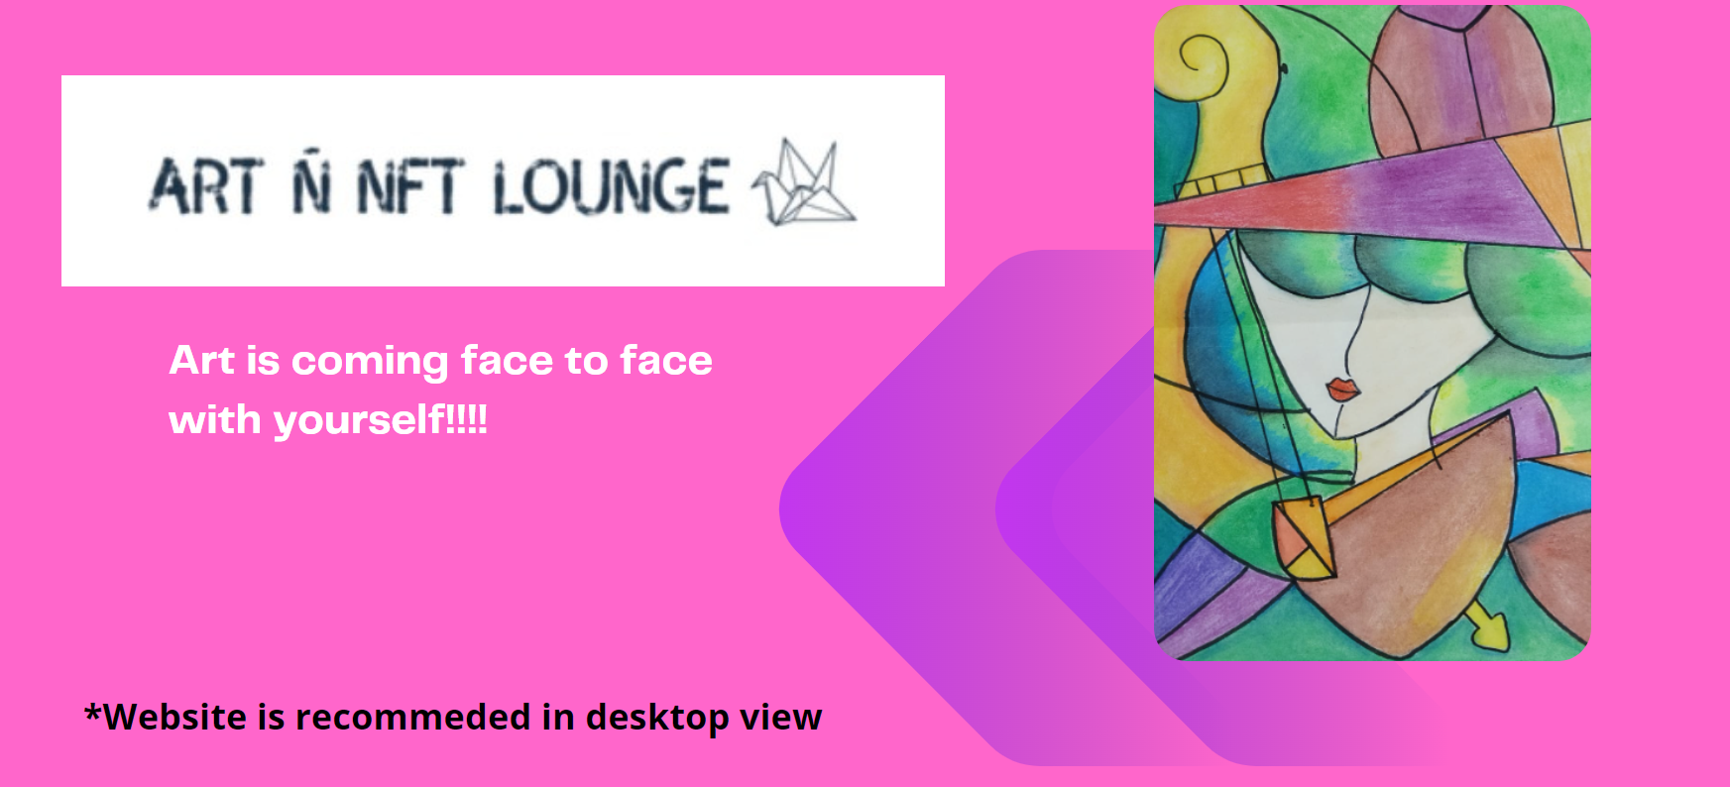
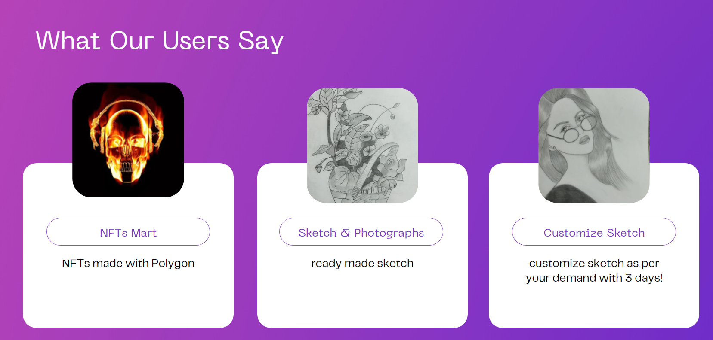
⭐DEMO⭐
Non-fungible means that these digital assets are unique and cannot be copied or replaced with anything else. These are digital assets on the blockchain, and each NFT has its own signature.
The ownership and authenticity of an NFT can be verified by those who want to buy it. NFTs are not only digital art, but they could be in the form of images, drawings, video clips, music, or text.

Slide 6

Key Differentiators & Adoption Plan
What other plans do they plan to sell connections? However, we believe that marketing helps to free up space in the market and create emotional connections with buyers. Yet who ignores our mistakes, remains loyal, and uses human biology on the market. With whisper marketing, let me believe that this product is a sign of luxury.
Yet who ignores our mistakes, remains loyal, and uses human biology on the market.

Slide 7
Future Vision
How far it can go?
I feel that there are many areas !! Then if you succeed in building the brand, the NFT will only be known as such in India. Secure Art Ñ NFT lounge and Reputation Space for the Next 5 Years It will be the best!
Secure Art-NFT Lounge and Reputation Space for the Next 5 Years

Slide 8
Your Aha Moment!
YAYA!!
We are still looking for some funky slogans
Give your kids fantastic sketches that are personalized for them and invest in nfts for long term and their future!!!
toh bhai ghar ka paisa ghar mai hi rahega na 🤪🤪

Slide 9
Thank You
Hemal Shingloo
Ishali Dubey

